Slide 1

Data-Efficient Strategies for Object Detection
IbPRIA 2025
Dinis Costa & Joana Costa
June 30

Slide 2
Tutorial Goals
Train an Object Detection model on custom data
01
Use Active Learning to reduce annotation workload
02
Understand how annotation quality affects model performance
03
Apply Transfer Learning to boost performance and reduce training time
04
Notes:
Justificar que é um tutorial mais pratico

Slide 3
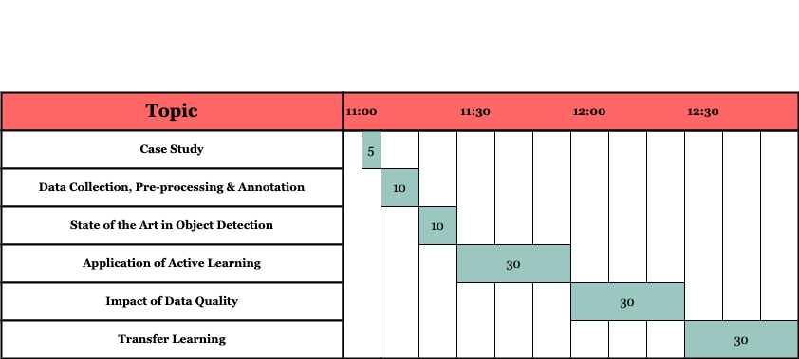
Agenda

Slide 4
Agenda
Case Study
Data collection, Pre-processing and Annotation
State of the Art in Object Detection
Application of Active Learning
Impact of Data Quality
Transfer Learning

Slide 5
Case Study Motivation
Pests destroy up to 40% of crops globally
Traditional pest control is costly, chemical-heavy, and often reactive
Feeding the world sustainably requires smarter farming : more precise and proactive
Early detection can save billions and reduce pesticide use, which means healthier crops, safer food, and a greener plane
Data-driven farming is the future

Slide 6
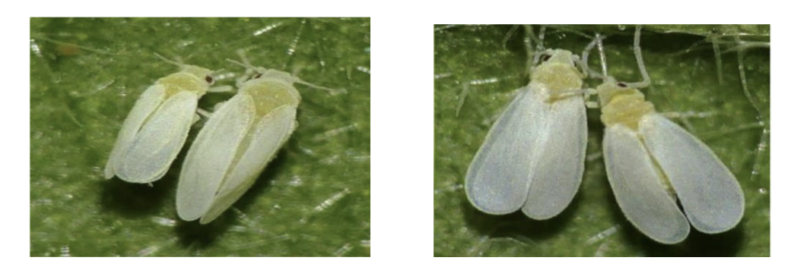
Case Study The whitefly pest
Pests destroy up to 40% of crops globally
Traditional pest control is costly, chemical-heavy, and often reactive
Feeding the world sustainably requires smarter farming : more precise and proactive
Early detection can save billions and reduce pesticide use, which means healthier crops, safer food, and a greener plane
Data-driven farming is the future

Slide 7
Case Study Motivation
Pest detection
Whitefly Pest
Detections in Natural Environments
Goal is to detect and count whiteflies present in the image

Slide 8
Case Study

Slide 9
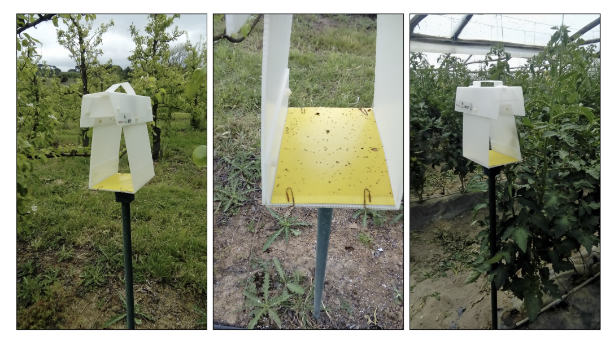
Case Study

Slide 10
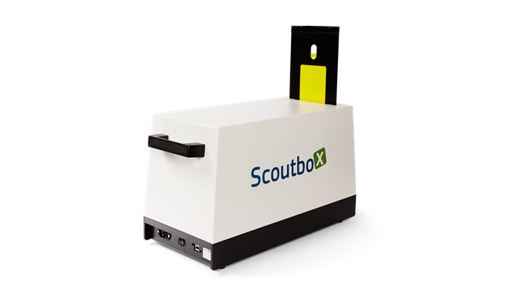
Case Study
Pest detection - importance

Slide 11
Data Collection
Diversity is Critical
Represent the real-world use case
Balance the dataset

Slide 12
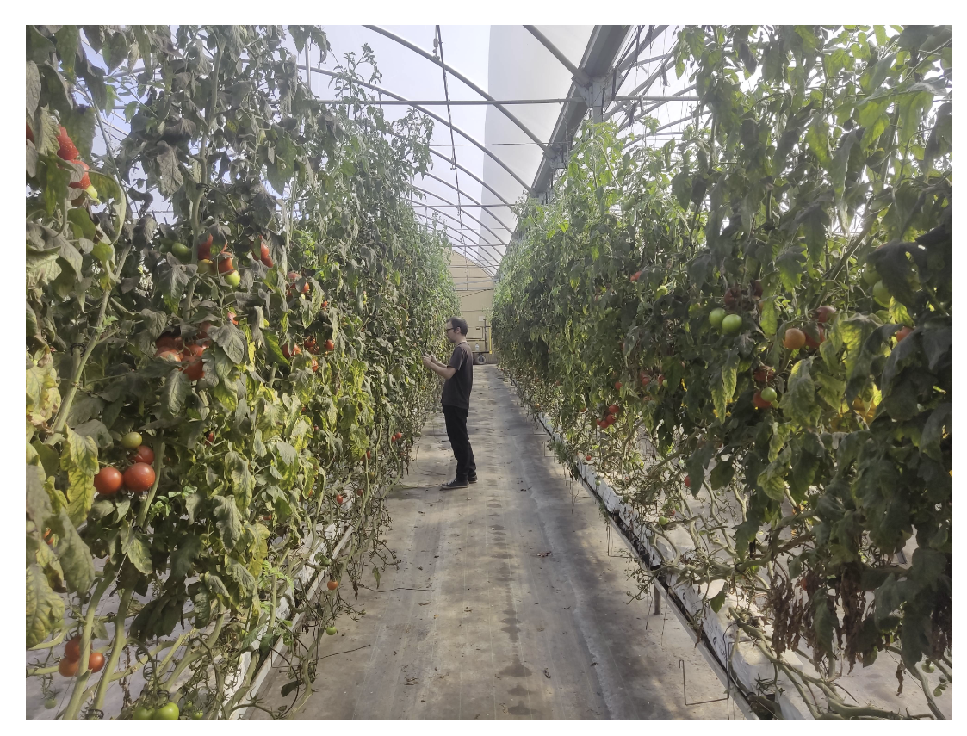
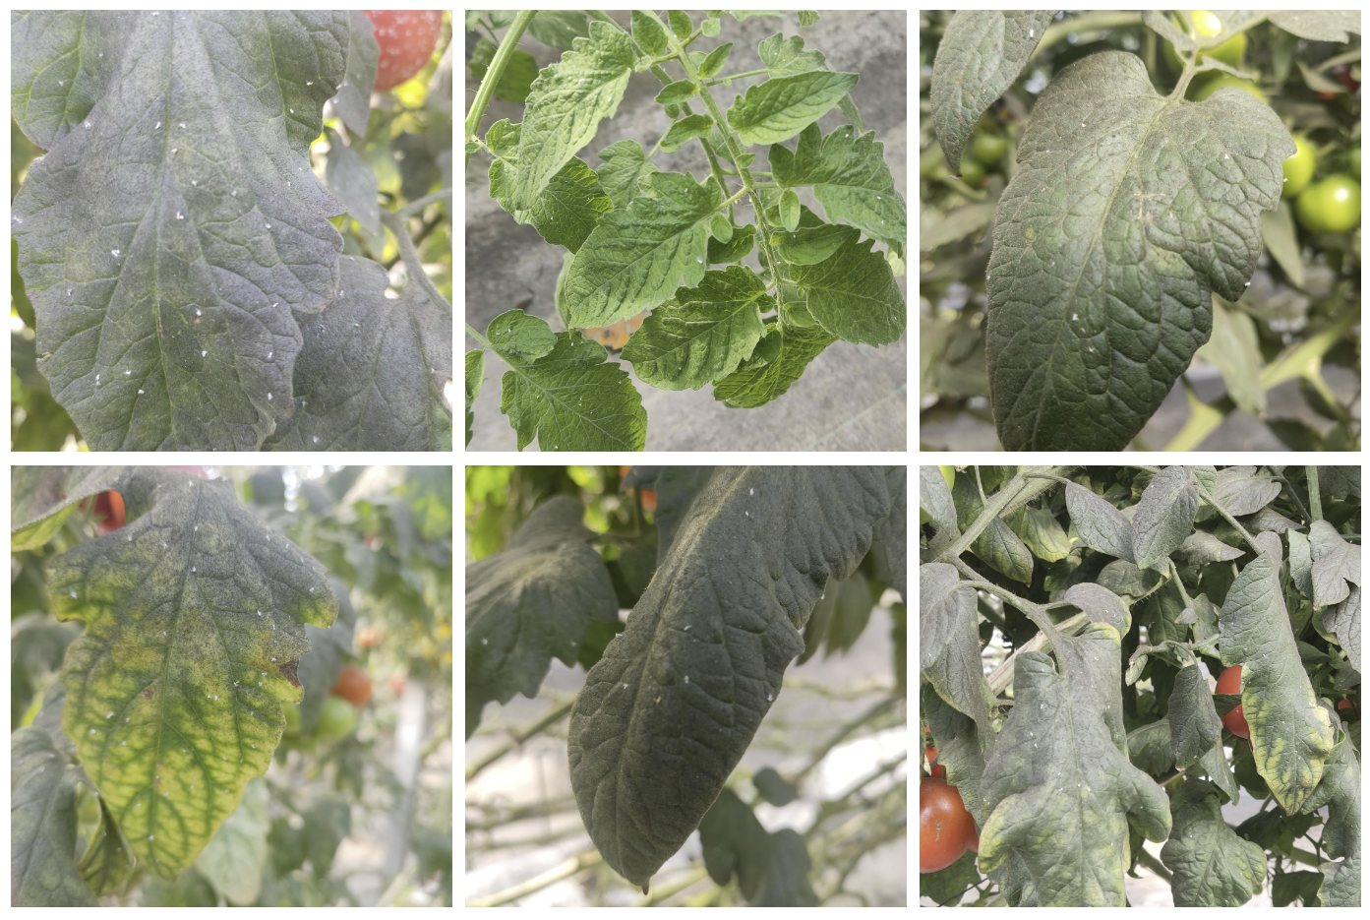
Data Collection

Slide 13
Annotation
The center of the bounding box should align with the center of the corresponding object.
The edges of the bounding box should not exceed the boundaries of the object.
Boxes should be tight but not overly precise — enough to capture the object clearly without including background noise.

Slide 14

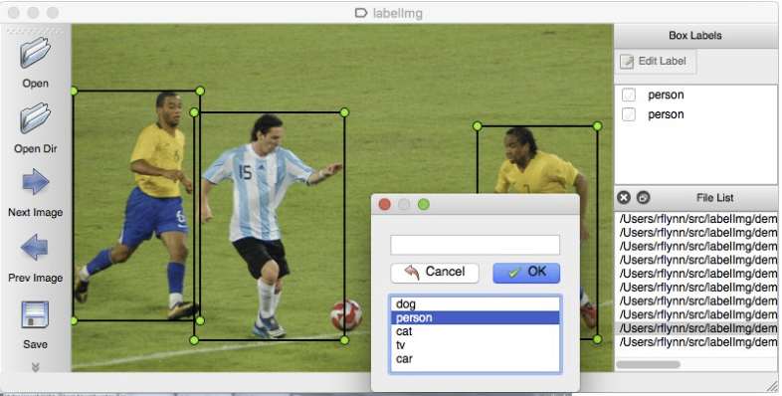
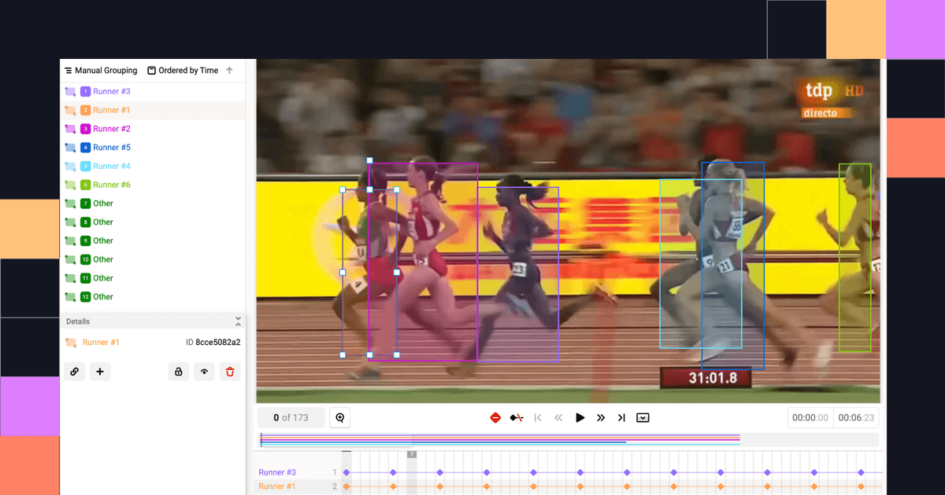
Annotation
LabelImg

Slide 15
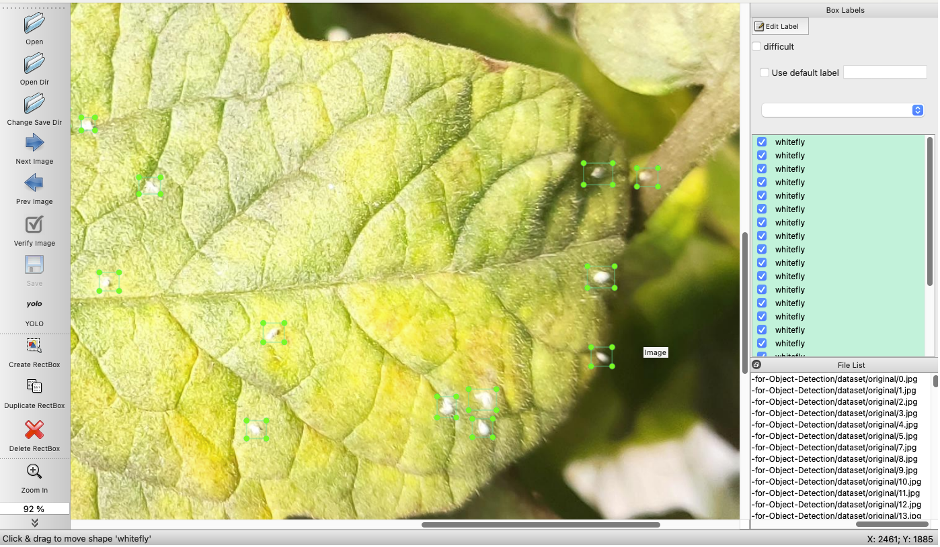
Annotation

Slide 16
Annotation
📂 dataset/
├── image_1.jpg
├── image_1.txt
├── image_2.jpg
├── image_2.txt
├── image_3.jpg
├── image_3.txt
└── ...
[class_id] [center_x] [center_y] [width] [height]
0 0.512 0.634 0.120 0.200 # object of class 0
1 0.278 0.401 0.150 0.180 # object of class 1

Slide 17
State-of-the-Art in Object Detection

Slide 18
State-of-the-Art in Object Detection One Stage vs Two Stage Model
1-Stage Detectors
Use Cases:
Real-time applications (e.g., drones, robotics, video surveillance)
Edge devices (e.g., Jetson Nano, Raspberry Pi)
Scenarios where speed is more critical than slight accuracy gains
Examples:
YOLO (v1 → v11)
SSD (Single Shot Multibox Detector)
DETR (transformer-based, one-stage-style)
2-Stage Detectors
Use Cases:
High-accuracy applications (e.g., medical imaging, autonomous vehicles)
Offline processing (speed not critical)
Complex scenes with small or overlapping objects
Examples:
RCNN
Fast RCNN
Faster RCNN

Slide 19
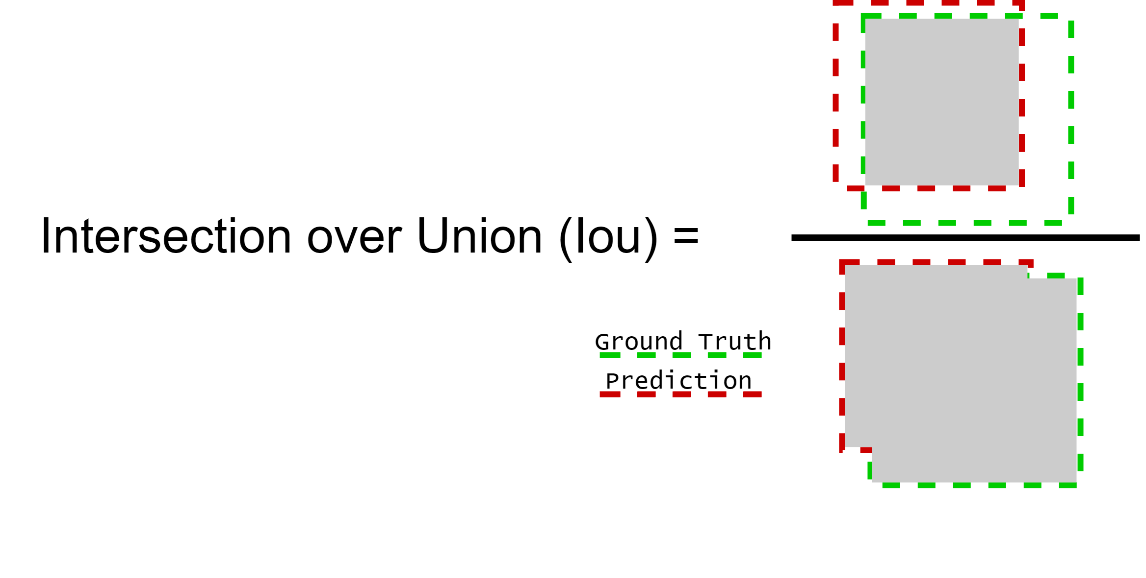
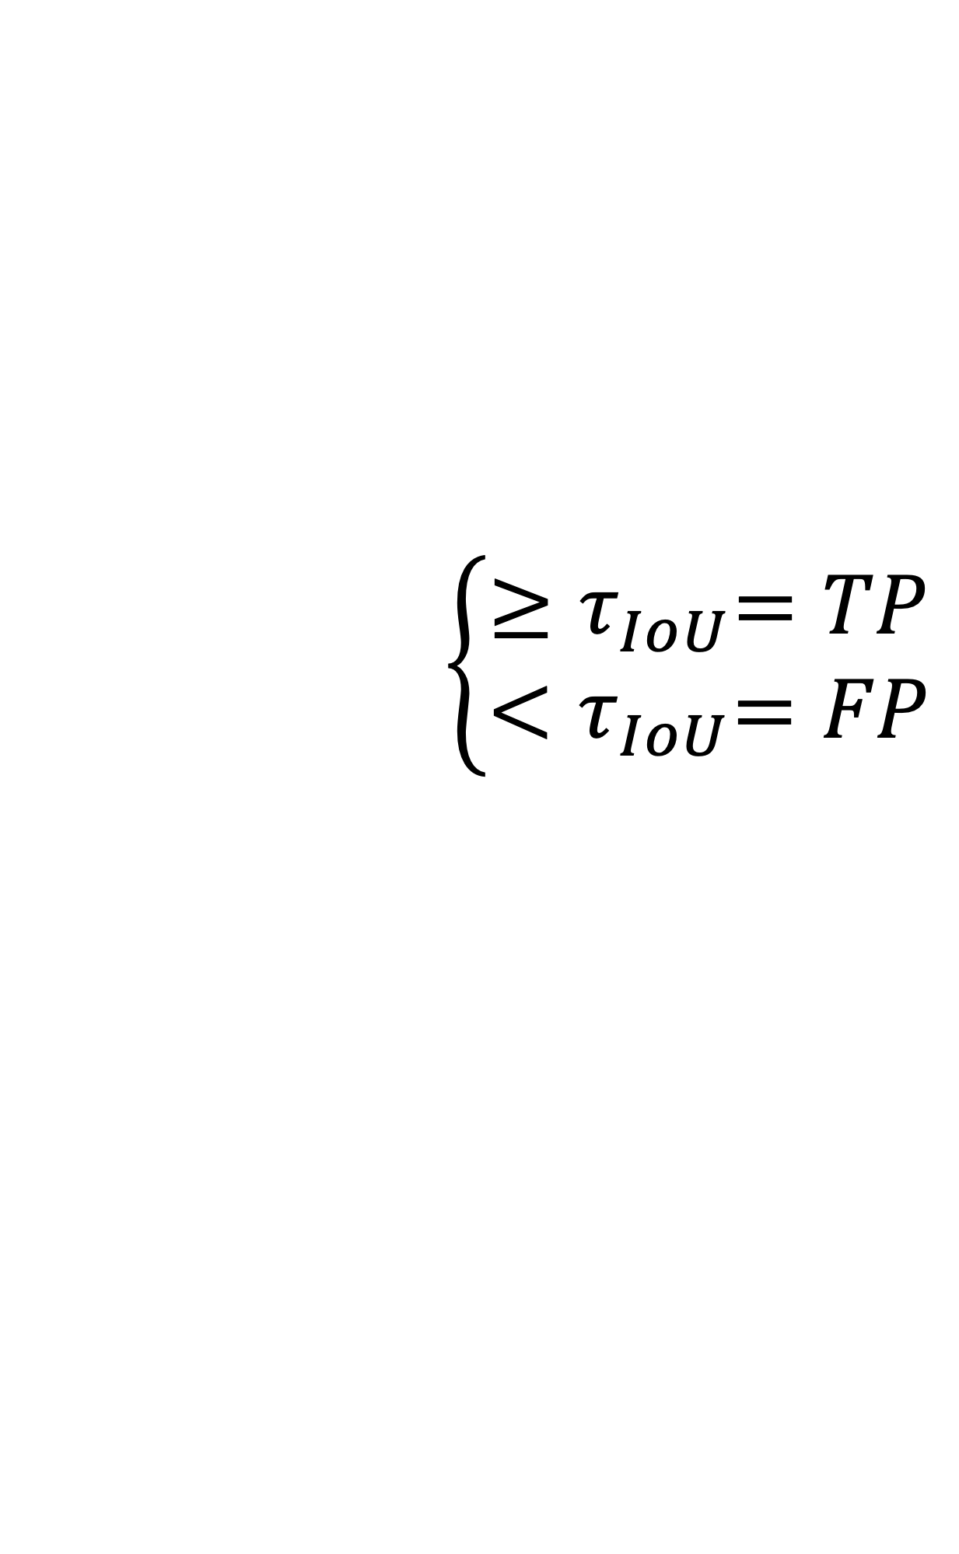
State-of-the-Art in Object Detection Metrics
$$\left\{\begin{aligned}{≥τ}_{IoU}=TP \\ {<τ}_{IoU}=FP\end{aligned}\right.$$

Slide 20


State-of-the-Art in Object Detection Metrics
Precision $= \frac{TP}{TP+FP}$
Recall $= \frac{TP}{TP+FN}$

Slide 21
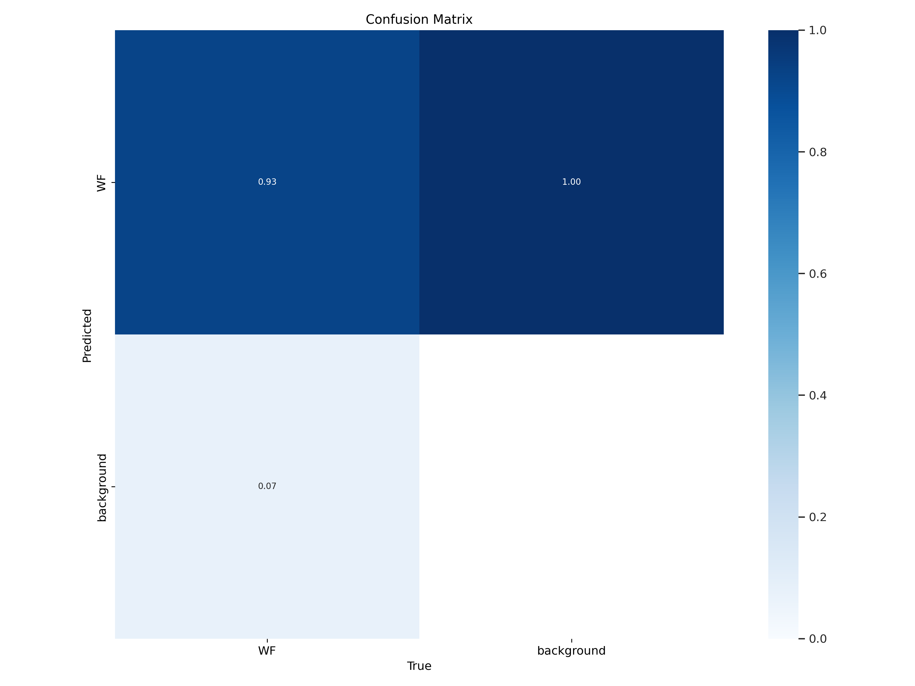


State-of-the-Art in Object Detection Metrics
Precision $= \frac{TP}{TP+FP}$
Recall $= \frac{TP}{TP+FN}$

Slide 22
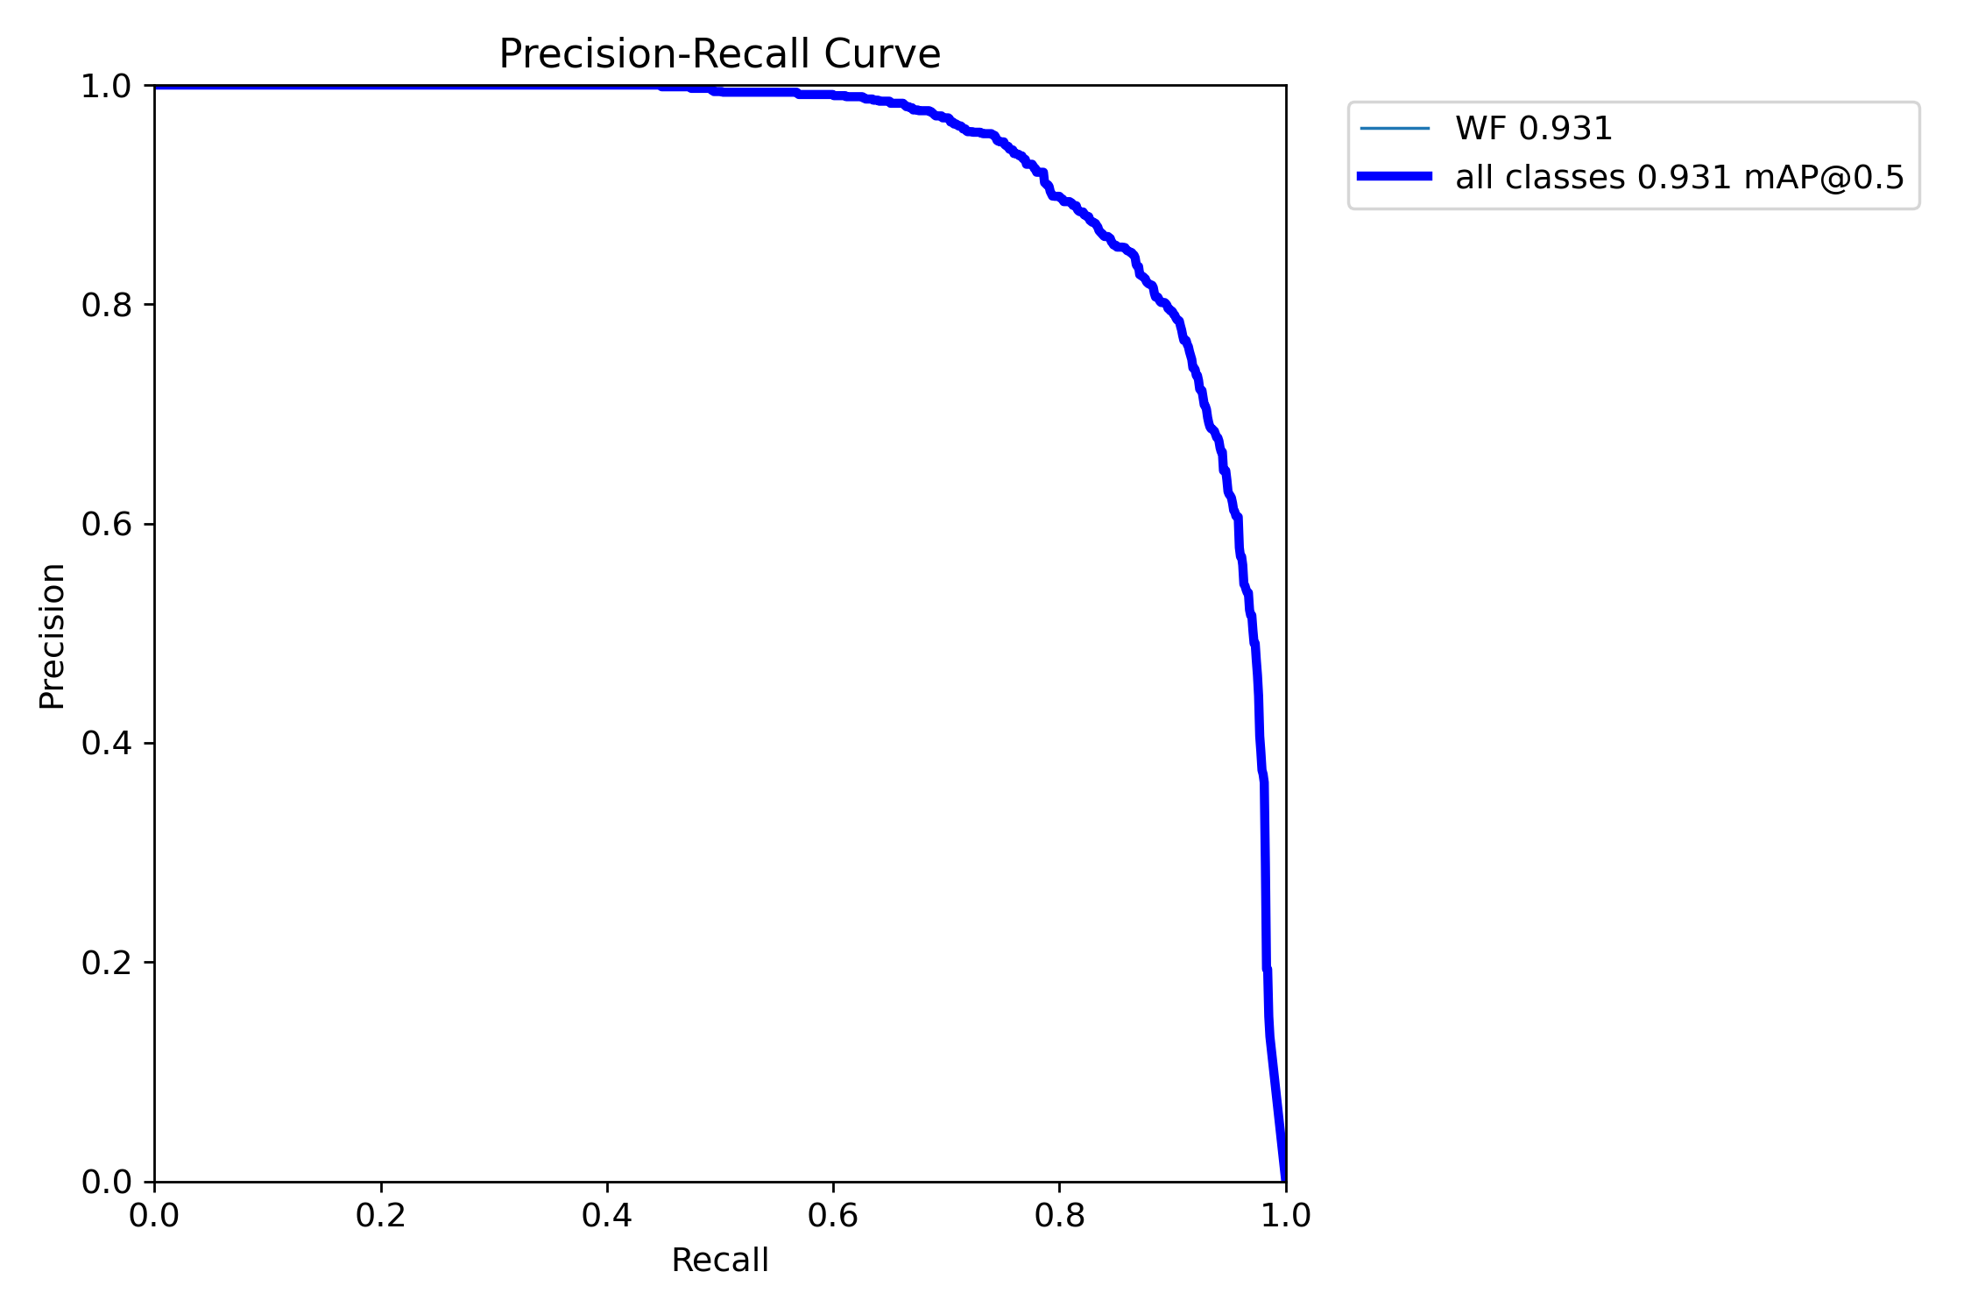
State-of-the-Art in Object Detection Metrics – mean Average Precision (mAP)

Slide 23
Active Learning

Slide 24
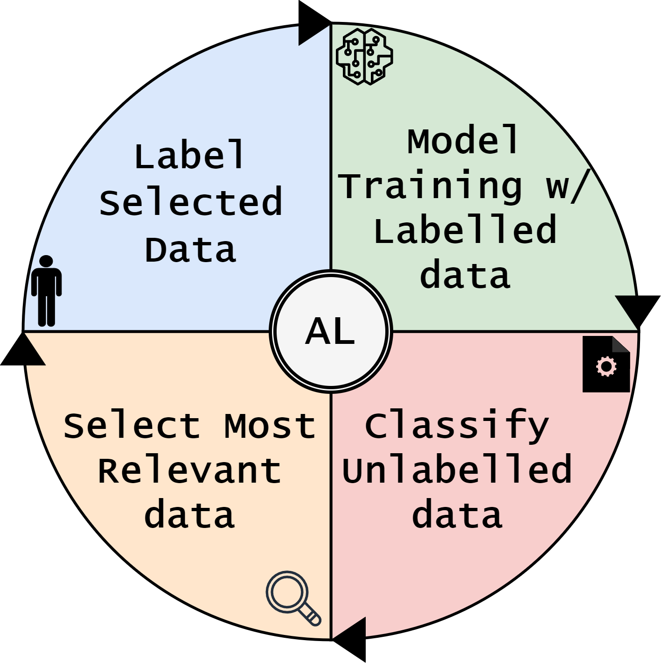
Active Learning
Select most relevant samples for training
Reduce Annotations Efforts
Improve Training Efficiency

Slide 25


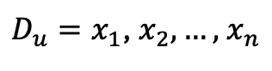
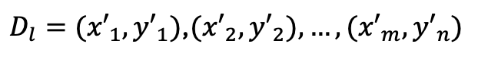
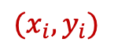
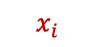
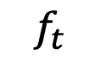
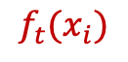
Active Learning
$$x_{i}$$
$${(x}_{i},y_{i})$$
Reject
Label
Oracle
Labelled Set
Unlabelled Set
$D_{u}=x_{1}$, $x_{2},…,$ $x_{n}$
$D_{l}={(x′}_{1},{y′}_{1})$,${(x′}_{2},{y′}_{2}),…,{(x′}_{m},{y′}_{n})$
$${f_{t}(x}_{i})$$
Uncertainty
$$x_{i}$$
Selects
Classifier
Train/update
$$f_{t}$$

Slide 26
Active Learning Expectation
mAP
Random Selected
Actively Selected
# samples

Slide 27
Active Learning
Hands on

Slide 28
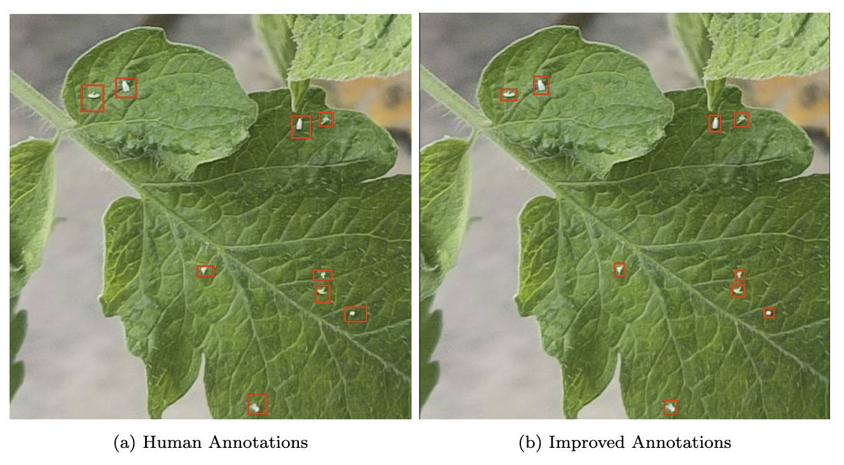
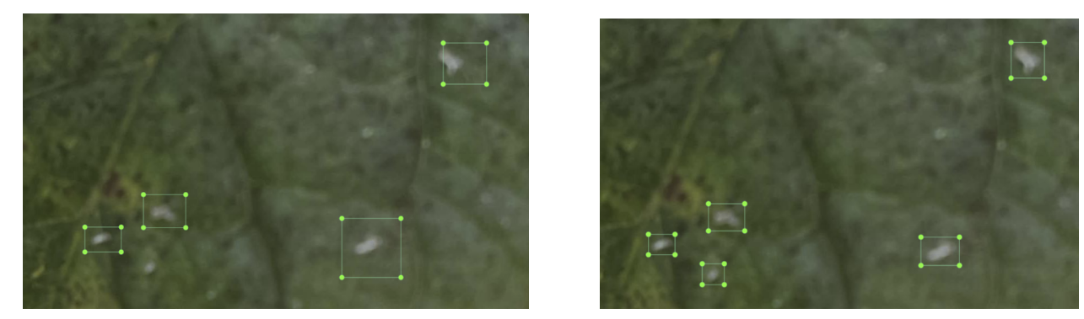
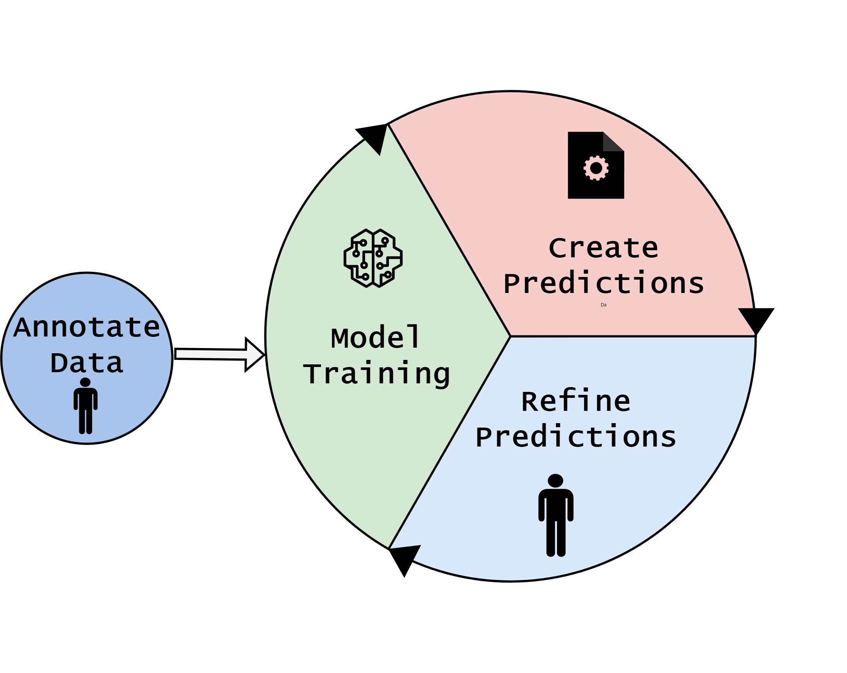
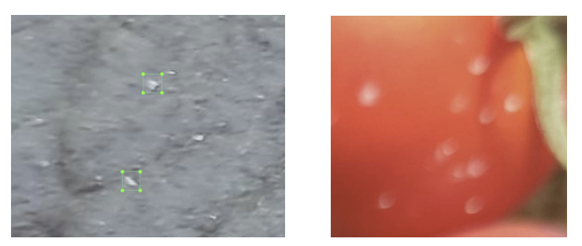
Data Quality
Key diffs
Impact
Ponte para mAP IoU - bbox

Slide 29
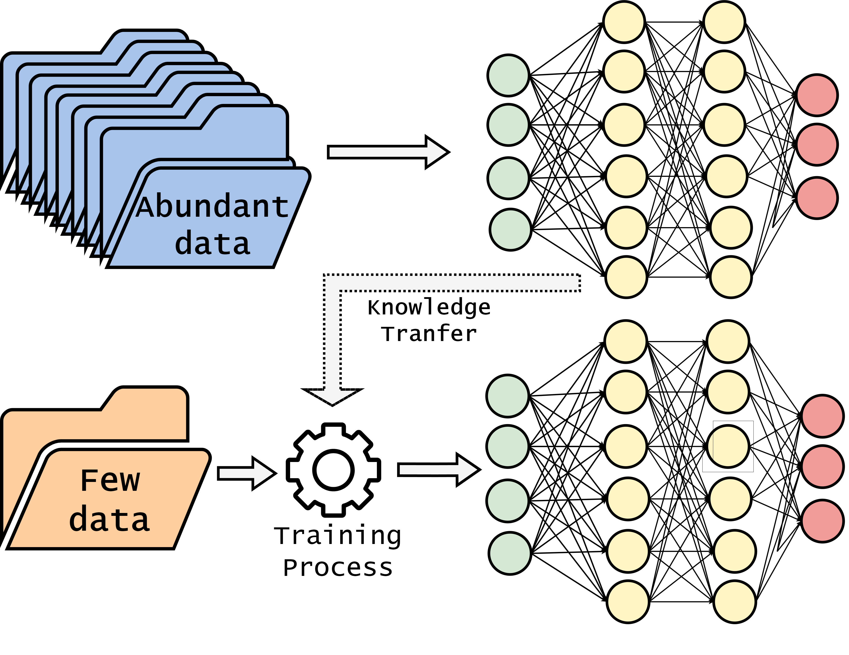
Transfer Learning

